Slide 1

Spring Fundamentals
Spring Boot Introduction
SoftUni Team
Technical Trainers
Software University
https://softuni.bg

Slide 2
Table of Content
What's Spring Boot?
Spring Data

Slide 3
Questions
sli.do #java-web

Slide 4

What is Spring Boot?

Slide 5




Spring Boot
Opinionated view of building production-ready Spring applications
Tomcat
pom.xml
Spring Boot
Auto configuration

Slide 6
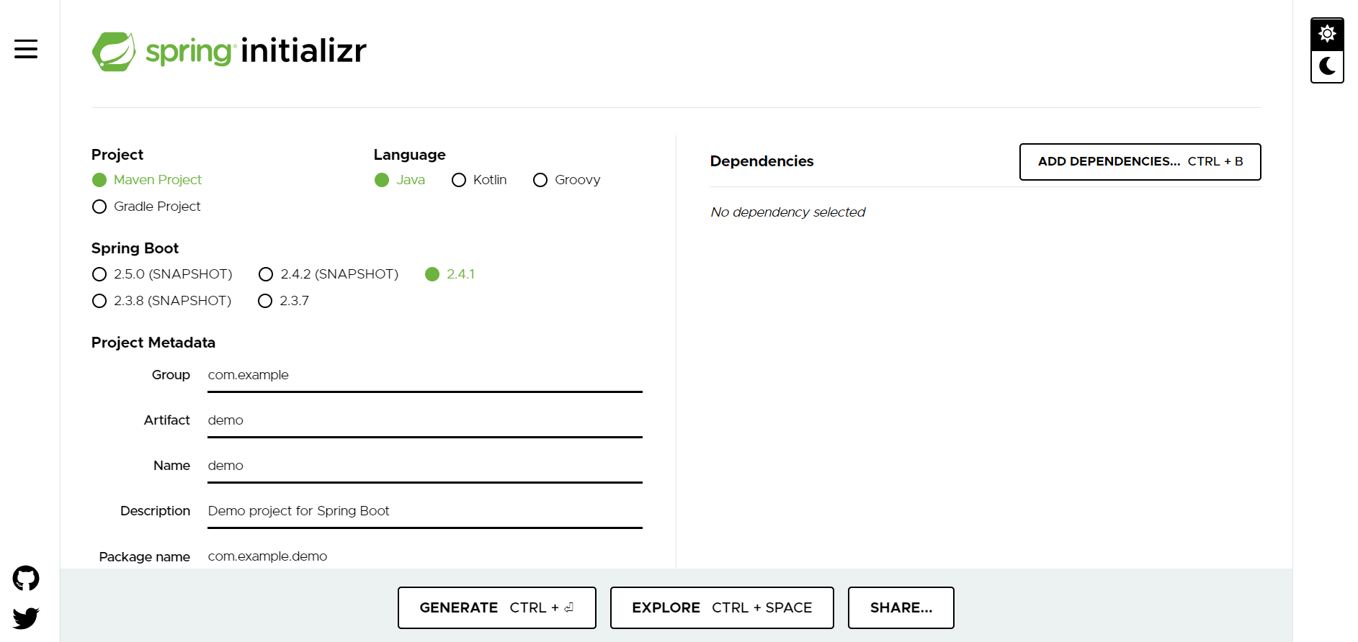
Creating Spring Boot Project
Just go to https://start.spring.io/

Slide 7
Spring Dev Tools
Additional set of tools that can make the application development faster and more enjoyable
pom.xml
<dependency> <groupId>org.springframework.boot</groupId> <artifactId>spring-boot-devtools</artifactId> <scope>runtime</scope> </dependency>

Slide 8
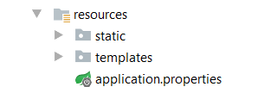
Spring Resources
HTML, CSS, JS
Thymeleaf templates
Application properties

Slide 9
Spring Boot Main Components
Some main components:
Spring Boot Starters - combine a group of common or related dependencies into single dependency
Spring Boot Auto-Configuration - reduce the Spring Configuration
Spring Boot CLI - run and test Spring Boot applications from command prompt
Spring Boot Actuator – provides EndPoints and Metrics

Slide 10
Spring Boot Starters
spring-boot-starter-web
spring-boot-starter-tomcat
spring-web
spring-boot-starter
spring-web-mvc
spring-boot
tomcat-embed-logging-juli
spring-boot-autoconfigure
tomcat-embed-core
spring-boot-starter-logging

Slide 11
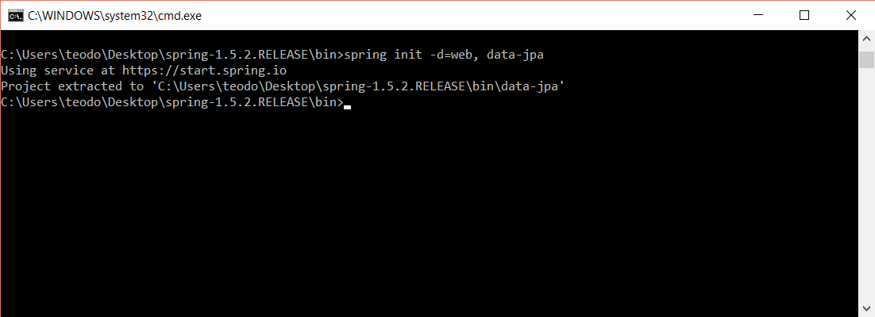
Spring Boot CLI
Command Line Interface - Spring Boot software to run and test Spring Boot applications

Slide 12
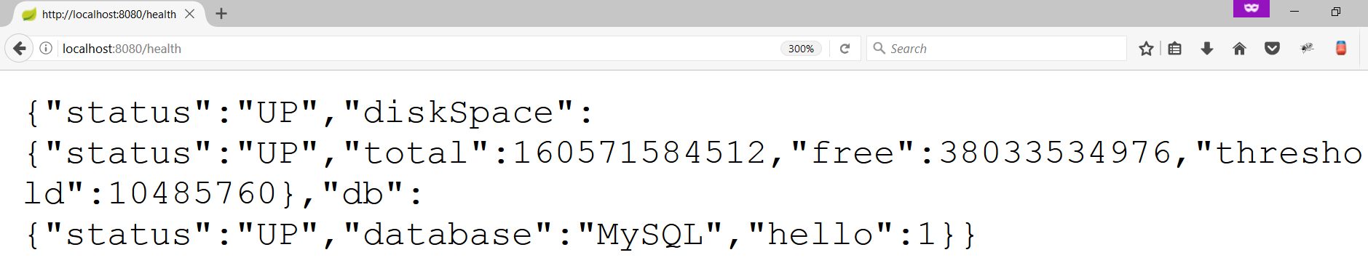
Spring Boot Actuator
Expose different types of information about the running application
pom.xml
<dependency>
<groupId>org.springframework.boot</groupId>
<artifactId>spring-boot-starter-actuator</artifactId>
</dependency>

Slide 13
Inversion of Control
Spring provides Inversion of Control and Dependency Injection
UserServiceImpl.java
UserServiceImpl.java
//Traditional Way
public class UserServiceImpl implements UserService {
private UserRepository userRepository = new UserRepository();
}
//Dependency Injection
@Service
public class UserServiceImpl implements UserService {
@Autowired
private UserRepository userRepository;
}

Slide 14
Spring IoC
Meta Data:
XML Config
Java Config
Automatic Beans:
@Component
@Service
@Repository
Explicit Beans
1. @Bean
IoC
Fully Configured System

Slide 15
Beans
Object that is instantiated, assembled, and otherwise managed by a Spring IoC container
Dog.java
public class Dog implements Animal {
private String name;
public Dog() {}
//GETTERS AND SETTERS
}

Slide 16
Bean Declaration
MainApplication.java
@SpringBootApplication
public class MainApplication {
…
@Bean
public Animal getDog(){
return new Dog();
}
}
Bean Declaration

Slide 17
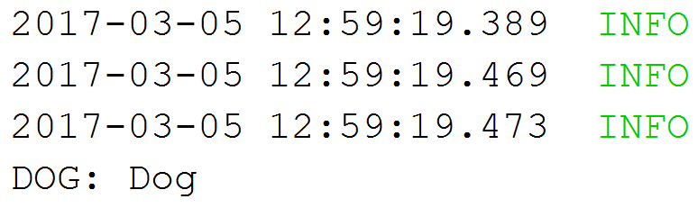
Get Bean from Application Context
MainApplication.java
@SpringBootApplication
public class MainApplication {
public static void main(String[] args) {
ApplicationContext context = SpringApplication.run(MainApplication.class, args);
Animal dog = context.getBean(Dog.class);
System.out.println("DOG: " + dog.getClass().getSimpleName());
}
}

Slide 18
Beans Scopes in Spring Framework
There are part of Beans scopes:
Singleton
Prototype
Request
Session
Global Session

Slide 19
Singletone Scope
Container creates a single instance of that bean, and all requests for that bean name will return the same object, which is cached
This is default scope
@Bean
@Scope("singleton") <- Can be omitted
public Student student() {
return new Student();
}

Slide 20
Prototype Scope
Will return a different instance every time it is requested from the container
@Bean
@Scope("prototype")
public Student student() {
return new Student();
}

Slide 21
Bean Scope
The default one is Singleton. It is easy to change to Prototype
Mostly used as State-less
Mostly used as State-full
Singleton
Prototype
Request A
Request A
Dog 1
Request B
Dog
Request B
Dog 2
Request C
Request C
Dog 3

Slide 22
Request Scope
A different bean instance being returned for each request
@Bean
@RequestScope
public StatBean statBean() {
return new StatBean();
}

Slide 23
Session Scope
Will creates the bean instance for the lifecycle of a session
@Bean
@SessionScope
public StatBean statBean() {
return new StatBean();
}

Slide 24
Application Scope
Will creates the bean instance for the lifecycle of a ServletContext.
@Bean
@ApplicationScope
public StatBean statBean() {
return new StatBean();
}

Slide 25
WebSocet Scope
The same instance of the bean is returned whenever that bean is accessed during the entire WebSocket session.
@Bean
@Scope(scopeName = "websocket", proxyMode = ScopedProxyMode.TARGET_CLASS)
public StatBean statBean() {
return new StatBean();
}

Slide 26
Bean Lifecycle
Instantiation
Set Properties
Set Name
Initialization
Pre Initialization
Set Application Context
Container Shutdown
Post Initialization
Bean is ready
Bean is destroyed

Slide 27
Bean Lifecycle Demo (1)
MainApplication.java
@SpringBootApplication
public class MainApplication {
public static void main(String[] args) {
ApplicationContext context = SpringApplication.run(MainApplication.class, args);
((AbstractApplicationContext)context).close();
}
@Bean(destroyMethod = "destroy", initMethod = "init")
public Animal getDog(){
return new Dog();
}
}

Slide 28

Bean Lifecycle Demo (2)
MainApplication.java
public class Dog implements Animal {
public Dog() {
System.out.println("Instantiation");
}
public void init(){
System.out.println("Initializing..");
}
public void destroy(){
System.out.println("Destroying..");
}
}

Slide 29
PostConstruct Annotation
Spring calls methods annotated with @PostConstruct only once, just after the initialization of bean
@Component
public class DbInit {
private final UserRepository userRepository;
public DbUnit(UserRepository userRepository)
{ this. userRepository = userRepository;}
@PostConstruct
private void postConstruct() {
User admin = new User("admin", "admin password");
User normalUser = new User("user", "user password");
userRepository.save(admin, normalUser);
}
}

Slide 30
PreDestroy Annotation
A method annotated with @PreDestroy runs only once, just before Spring removes our bean from the application context
@Component
public class UserRepository {
private DbConnection dbConnection;
@PreDestroy
public void preDestroy() {
dbConnection.close();
}
}

Slide 31
PostConstruct & PreDestroy with Java 9+
@PostConstruct and @PreDestroy annotations are part of Java EE. And since Java EE has been deprecated in Java 9 and removed in Java 11 we have to add an additional dependency to use these annotations:
pom.xml
<dependency>
<groupId>javax.annotation</groupId>
<artifactId>javax.annotation-api</artifactId>
<version>1.3.2</version>
</dependency>

Slide 32
BeanNameAware Interface
BeanNameAware makes the object aware of the bean name defined in the container
public class MyBeanName implements BeanNameAware {
@Override
public void setBeanName(String beanName) {
System.out.println(beanName);
}
}
@Configuration
public class Config {
@Bean (name = "myCustomBeanName")
public MyBeanName getMyBeanName() {
return new MyBeanName();
}
}

Slide 33
BeanFactoryAware Interface
BeanFactoryAware is used to inject the BeanFactory object
With the setBeanFactory() method, we assign the BeanFactory reference from the IoC container to the beanFactory property
public class MyBeanFactory implements BeanFactoryAware {
private BeanFactory beanFactory;
@Override
public void setBeanFactory(BeanFactory beanFactory)throws BeansException {
this.beanFactory = beanFactory;}
public void getMyBeanName() {
MyBeanName myBeanName = beanFactory.getBean(MyBeanName.class);
System.out.println(beanFactory.isSingleton("myCustomBeanName"));
}
}

Slide 34
InitializingBean Interface
For bean implemented InitializingBean, it will run afterPropertiesSet() after all bean properties have been set
@Component
public class InitializingBeanExampleBean implements InitializingBean {
private static final Logger LOG
= Logger.getLogger(InitializingBeanExampleBean.class);
@Autowired
private Environment environment;
@Override
public void afterPropertiesSet() throws Exception {
LOG.info(Arrays.asList(environment.getDefaultProfiles()));
}
}

Slide 35
DisposableBean Interface
For bean implemented DisposableBean, it will run destroy() after Spring container is released the bean
@Component
public class Bean2 implements DisposableBean {
@Override
public void destroy() throws Exception {
System.out.println(
"Callback triggered - DisposableBean.");
}
}

Slide 36
Common Application Properties
Various properties can be specified inside your application.properties file
Property contributions can come from additional jar files
You can define your own properties
Link to documentation

Slide 37
Application Properties Example
application.properties
spring.datasource.driverClassName=com.mysql.cj.jdbc.Driver
spring.datasource.url=jdbc:mysql://localhost:3306/thymeleaf_adv_lab_exam_db?createDatabaseIfNotExist=true
spring.datasource.username=root
spring.datasource.password=12345
spring.jpa.properties.hibernate.dialect = org.hibernate.dialect.MySQL8Dialect
spring.jpa.properties.hibernate.format_sql = TRUE
spring.jpa.hibernate.ddl-auto = update
spring.jpa.open-in-view=false
logging.level.org = WARN
logging.level.blog = WARN
logging.level.org.hibernate.SQL = DEBUG
logging.level.org.hibernate.type.descriptor = TRACE
server.port=8000

Slide 38
Application Yaml Example
application.yaml
spring:
datasource:
driverClassName: com.mysql.cj.jdbc.Driver
password: 12345
url: jdbc:mysql://localhost:3306/spring_data_lab_db?allowPublicKeyRetrieval=true&useSSL=false&createDatabaseIfNotExist=true
username: root
jpa:
database-platform: org.hibernate.dialect.MySQL8Dialect
hibernate:
ddl-auto: create-drop
open-in-view: false
properties:
hibernate:
format_sql: true

Slide 39

Spring Data

Slide 40
Overall Architecture
Repository
Service
Controller
Database
View
Entities
Models/ DTO
Back-End

Slide 41
Entities
Entity is a lightweight persistence domain object
Cat.java
@Entity
@Table(name = "cats")
public class Cat {
@Id
@GeneratedValue(strategy = GenerationType.IDENTITY)
private long id;
private String name;
//GETTERS AND SETTERS
}

Slide 42
Repositories
Persistence layer that works with entities
CatRepository.java
@Repository
public interface CatRepository extends JpaRepository<Cat, Long> {
}

Slide 43
Services
Business Layer - All the business logic is here.
CatService.java
@Service
public class CatServiceImpl implements CatService {
private final CatRepository catRepository;
@Autowired
public CatServiceImpl(CatRepository catRepository){
this.catRepository = catRepository;
}
@Override
public void buyCat(CatModel catModel) { //TODO Implement the method }
}

Slide 44

Summary
Spring Boot - Opinionated view of building production-ready Spring applications
Spring Data - Responsible for database related operations
…
…
…

Slide 45
Questions?
Notes:
45

Slide 46










SoftUni Diamond Partners

Slide 47



Educational Partners

Slide 48
Trainings @ Software University (SoftUni)
Software University – High-Quality Education, Profession and Job for Software Developers
softuni.bg, about.softuni.bg
Software University Foundation
softuni.foundation
Software University @ Facebook
facebook.com/SoftwareUniversity
Software University Forums
forum.softuni.bg
Notes:
48

Slide 49

License
This course (slides, examples, demos, exercises, homework, documents, videos and other assets) is copyrighted content
Unauthorized copy, reproduction or use is illegal
© SoftUni – https://about.softuni.bg/
© Software University – https://softuni.bg
Notes:
49

